Slide 1
Overview of Recommendation and Insights
YANG Chunfeng
yc012@ie.cuhk.edu.hk

Slide 2
Outline
Data sources
Algorithm summary
Challenges
Evaluation
Concerned issues
Ideas

Slide 3
Data sources
Data sources
Social connections (Social graph, web of trust)
User demographic info (user profile)
Ratings(Explicit & Implicit):User activities
Item profiles
User behaviors data/clickstream: page views, click-thru, watch video, search log, favorite, vote/rating, share, review. (context: timestamp, location, mood; engagement) (red is for large size, blue is for middle size, purple is for small size; bold is for all users, italic is for registered user)

Slide 4
Algorithms
Rule-based algorithms
Association Rule
Collaborative filtering
Memory-based (neighbor-based)
Model-based
Content-based algorithms
Social filtering (graph-based)
Dynamic/temporal algorithms
Hybrid algorithms
Notes:
Association Rule can be regarded as memory-based with one-hop

Slide 5
Algorithms
Rule-based algorithms
Association Rule
Collaborative filtering
Memory-based (neighbor-based)
Model-based
Content-based algorithms
Social filtering (graph-based)
Demographic filtering
Dynamic/temporal algorithms
Hybrid algorithms
Notes:
Association Rule can be regarded as memory-based with one-hop

Slide 6
Memory-based CF
Also as neighbor-based CF
Distance (neighbor hop #)
One-hop: user-based/item-based CF; Association Rule;
Multi-hops (graph-based): random walker; trust walker
Main disadvantages:
Sparsity(& cold start)
Scalability

Slide 7
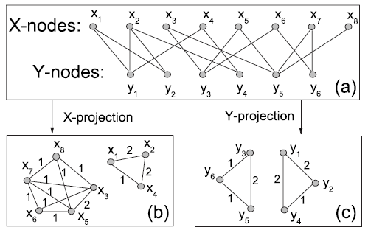
Graph-based:
Social graph/web of trust: real social connections
co-viewed/co-rated/co-tagged/co-reviewed graph
(Bipartite graph/Affiliation Network, such as user-item rating matrix, can be converted to such graph(Markov network/Markov Random Fields)：Bipartite network projection(one-mode) )
Bipartite graph
One-mode graph
(behavioral graph/correlation graph)

Slide 8
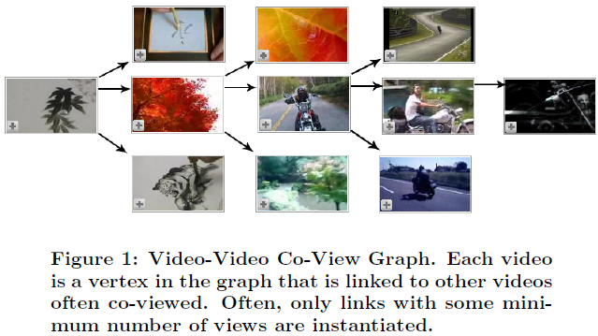
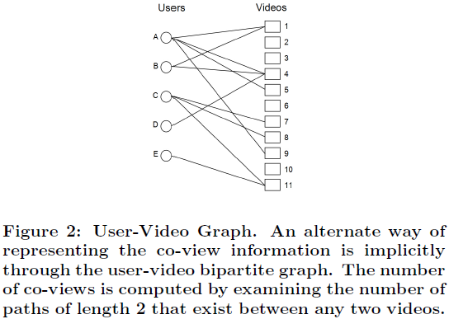
co-view graph
user-video graph

Slide 9
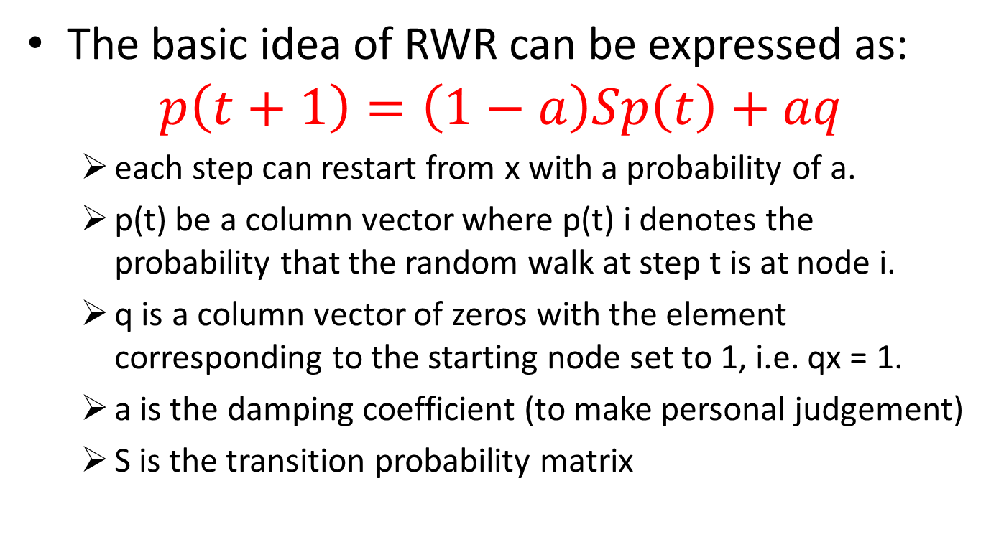
Random Walk with Restart (RWR)
The basic idea of RWR can be expressed as:
$$p\left(t+1\right)=\left(1−a\right)Sp\left(t\right)+aq$$
each step can restart from x with a probability of a.
p(t) be a column vector where p(t) i denotes the probability that the random walk at step t is at node i.
q is a column vector of zeros with the element corresponding to the starting node set to 1, i.e. qx = 1.
a is the damping coefficient (to make personal judgement)
S is the transition probability matrix
Almost the same as Google topic-specific PageRank with random teleport

Slide 10
Random Walk with Restart (cont.)
If we want to recommend resources to user i, we will mark node i as the starting node.
q is a vector in which the element corresponding to the starting node is set to 1.
So it should be easily accessible to the node which is closer to the starting node that they would get greater stationary probabilities.
Therefore, after the iteration converges, we sort the nodes with their stationary probabilities. The node with larger stationary probability is closer to the target node

Slide 11
Algorithms
Rule-based algorithms
Association Rule
Collaborative filtering
Memory-based (neighbor-based)
Model-based
Content-based algorithms
Social filtering (graph-based)
Dynamic/temporal algorithms
Hybrid algorithms
Notes:
Association Rule can be regarded as memory-based with one-hop

Slide 12
Model-based CF
Main cost lies in modeling(training)
Bayesian belief nets (BNs) CF models
Clustering CF models
Latent feature model(MF, SVD)
MDP (Markov decision process)-based CF
RBM (Restricted Boltzmann Machines)-based CF
Main disadvantage:
Explainability

Slide 13
Algorithms
Rule-based algorithms
Association Rule
Collaborative filtering
Memory-based (neighbor-based)
Model-based
Content-based algorithms
Social filtering (graph-based)
Dynamic/temporal algorithms
Hybrid algorithms
Notes:
Association Rule can be regarded as memory-based with one-hop

Slide 14
Content-based
Feature weighting:
Key Idea: different weight on features
Debnath et. al. Feature Weighting in Content Based Recommendation System Using Social Network Analysis. WWW’08 Poster.
Methodology
-- rating matrix → movie “co-like” social graph
-- movie profile (14 features) → movie distance
-- S(m1, m2) = w1*dist1(m1, m2) + … + wi*disti(m1, m2) + ...
-- Linear Regression → wi

Slide 15
Content-based
Other content-based approaches contain: Topic modeling, Bayesian Network, KNN, regression.

Slide 16
Algorithms
Rule-based algorithms
Association Rule
Collaborative filtering
Memory-based (neighbor-based)
Model-based
Content-based algorithms
Social filtering (graph-based)
Dynamic/temporal algorithms
Hybrid algorithms
Notes:
Association Rule can be regarded as memory-based with one-hop

Slide 17
Social filtering
Users’ trustworthiness has been measured according to one of the following two criteria:
taste similarity/assortativity(i.e., “I trust those who agree with me”) --correlational influence
social ties (i.e., “I trust my friends, and the people that my friends trust”). --social influence
The former criteria aims at identifying competent users, but is subject to abuse by malicious behaviors.
The latter aims at detecting well-intentioned users, but fails to capture the natural subjectivity of tastes

Slide 18
Algorithms
Rule-based algorithms
Association Rule
Collaborative filtering
Memory-based (neighbor-based)
Model-based
Content-based algorithms
Social filtering (graph-based)
Dynamic/temporal algorithms
Hybrid algorithms
Notes:
Association Rule can be regarded as memory-based with one-hop

Slide 19
Dynamic/temporal algorithms
Consider time effect
user preference
item popularity (corresponding to user preference)
Seasonal
Time Series Analysis theory(TSA)
Earlier ratings should impact the predictive feature less

Slide 20
Dynamic/temporal algorithms
In real video system:
recommendation(both prediction and system construction) needs to be related to time.(dynamic recommendation/freshness)
Temporal factor:
Freshness
Dynamic system: for new users, new items, new activities(including ratings), user preference, item popularity
Dynamic feature weighting(for user/item feature)

Slide 21
Algorithms
Rule-based algorithms
Association Rule
Collaborative filtering
Memory-based (neighbor-based)
Model-based
Content-based algorithms
Social filtering (graph-based)
Dynamic/temporal algorithms
Hybrid algorithms
Notes:
Association Rule can be regarded as memory-based with one-hop

Slide 22
Hybrid algorithm
Various types of combination
Use multiple data sources
Combine distinct algorithms
Use one result as the input of another
Display results in different sessions
Consider different scenarios
Utilize strengths, evade shortcomings
for new users, new items
unsigned users vs. signed users
Consider various video types
(MV, movie, TV, sports, news, UGC)

Slide 23
Short summary
Collaborative filtering:
Matrix (with rows, columns as different objects) → Affiliation network(Bipartite Graph) → (Through one mode projection): One mode Graph
For matrix: MF, SVD, PCA, LSH, CF
For graph: RWR, PageRank, SNA
Content based:
user feature(collaborative feature, social feature), item feature,
Machine learning (regression-based)

Slide 24
Challenges
Data Sparsity (use more data; graph-based multi-hop)
cold start
Scalability (efficiency)
Synonymy
Gray Sheep
Shilling Attacks
personal privacy(for social info)
Explainability
Increased noise
Notes:
MF(SVD) can lower the noise. FFT

Slide 25
Evaluation Metrics
Online:
Likelihood rating: QoE(view ratio) (rating prediction)
Consumption rating: CTR (top-n recommendation)
Offline:
Precision:
Numerical(rating prediction): MAE(mean average error(eliminate the impact of outlier/noise)); RMSE(root mean square error);
Binary: normalized discounted cumulative gain, (NDCG)F-measure(precision(hit-ratio), recall)(fit for top-N recommendation)
Efficiency (scalability)

Slide 26
Concerned issues
Concerned issues: popularity, personalization (historical records for both signed users or unsigned users with cookies), relatedness (content-based), diversity
Relatedness: the video being viewed
Personalization: every single video has its related video list. Then according to one user’s historical records, obtain all the video lists.( take the intersection/majority to preserve for the final personal recommendation)
Socialization also reflect the personalization

Slide 27
Ideas

Slide 28
Ideas -Dynamic rule-based recommendation (can deal with sparsity)
Association Rule(AR): one-hop (sparsity)→ Utilize Random Walker(RW)
Rules by AR are directed (from one item to another) → Directed graph for RW
Time issue in Association Rule → Rule construction consider temporal issue(assign time-related weight)
User preference lifecycle ---- item popularity lifecycle
Measure popularity lifecycle for different types of videos
Used in the type-specific time-related weighting

Slide 29
Ideas (cont.)
-Reshaping of Internet Traffic via Online Video Recommender System
Effects on video website workload
through clickstream data
analysis viewing source distribution(homepage navigation; search block, recommendation list; linked from other sites)
Different types (MV, movie, TV, sports, news, UGC)
hot videos & long tail videos
Propagation of recommendation (the effect of recommendation on content diffusion)
Video lifecycle of various types affected by Recommender System (MV, movie, TV, sports, news, UGC)

Slide 30
Ideas (cont.) -Social video measurement(Micro-UGC)
After the measurement of Tencent Weishi(social video), we can identify some specific user/social behaviors/activities (and the patterns).
With these observations, we can further apply to Social Video Recommendation in Social Network or Recommend Social Video to Video Website (previous work is social-based video recommendation in video website, or recommend video from video website to social network)
or obtain insights for socialized videos/ videolized social network(视频社交化/社交视频化).

Slide 31
Ideas (cont.)--Social Featuring
Utilize mobile-side data(user activities) for Tencent Weibo
1.Measure existing user activities(interaction or concurrency) that can be tracked.
2.Based on these to create social features/social profile (together with user profile)for each user. Social features can infer the social relation/similarity of users
3.Using regression or other machine learning approaches to do feature selection and assign weights to the selected features
User similarity indication: # of co-viewed videos.
Do regression to obtain the weights of these social features:
#(1,2) = w1*d1(f1,1;f2,1)+w2*d2(f2,1;f2,2)+…+wn*dn(fn,1;fn,2)
where #(1,2) is # of co-viewed videos for user1,user2;
di is the distance measure for social feature i.
4.These weighted social features can be used to do social recommendation:
1).relationship strength to predict rating to weighted sum directly.(Like the paper)
2).Used in the markov network as edge weight to do RWR.
3). social profile + user profile → item profile → user-item similarity
Notes:
“On Video Recommendation over Social Network”

Slide 32
Ideas (cont.)
--Type-specific and dynamic featuring
Content-based:
item profile → user profile → user-item similarity
item profile:
Feature weighting (using regression with co-rated,co-tagged,co-reviewed,co-viewed information) to obtain content/item features and their weights
Type-specific/dependent: doing such a process regarding different content features/feature weights for different type of videos (TV,movie,UGC)
Dynamic featuring
Item feature: earlier actions affect the similarity less; periodically compute item features
User feature: aggregated from item features(viewing/like records considering time refreshness)

Slide 33
behavioral profiling model
0-th order models: binary event recorded only, for instance: the list of websites that were visited.
1-st order models: frequencies, probability distributions, for instance: a Bernoulli style model indicating the likelihood that a site will be visited, based on a frequency count of previous visits.
2-nd order models: causality relations, time-dependencies, for instance: a hidden-Markov style model, with transitional probabilities between site accesses.

Slide 34
Social feature/social profile(on social media/network)
combine 1st order model and 2nd order model
1st order model:
2nd order model: (Association Rule)
user-item matrix only reflect the 1st order model of user profile. Combined with records by association rule in video websites(2nd order) in order to obtain a complete user behavior model/profiling.
There is some association between demographic profile and User’s Browsing/viewing Behavior.
Thus demographic information can be used for those who has few records for the user behavior model.

Slide 35
Designs/Algorithms highly depend on the available specific data structure.
Practical data!

Slide 36
Thank you!

Slide 38
Formulation (cont.)
Social network graph:
Social connection: user-based
Co-viewed/rated/tagged/reviewed social graph: item-based/user-based
Random Walk with Restart(RWR) to deal with social network graph (Personalized recommendation):
Graph-based clustering for social graph/spectral clustering(eigenvector, MST, Clustering coefficient)
Reference: “A Random Walk Method for Alleviating the Sparsity Problem in Collaborative Filtering”

Slide 39
Formulation
Combine many approaches: Social connection; artificial social network graph(through co-viewed/co-rated/co-tagged/co-reviewed records); Content-based(actor, director, release year, type, genre, keyword, country, language, company, etc.); Collaborative Filtering(+PMF).

Slide 40
Viewed records should be removed from the recommendation list.

